Slide 1
Course Code: CSC211A Course Title: Formal Languages and Automata Theory
Lecture 12: More properties of Regular language -2
Course Leader:
Prakash P
prakashp.cs.et@msruas.ac.in

Slide 2
Session Objectives
At the end of this session, student will be able to
Explain the pigeonhole principle
Understand the pumping lemma
Explain the applications of the pumping lemma

Slide 3
Session Topics
The Pigeonhole Principle
The Pumping Lemma
Applications of The Pumping Lemma

Slide 4

The Pigeonhole Principle

Slide 5
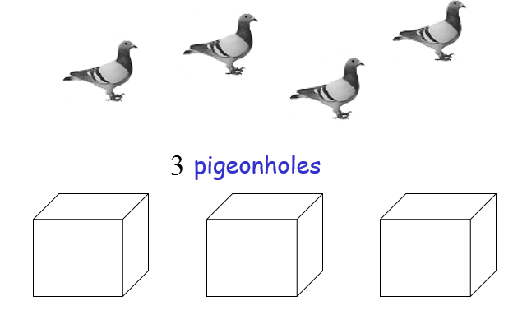
Pigeons

Slide 6
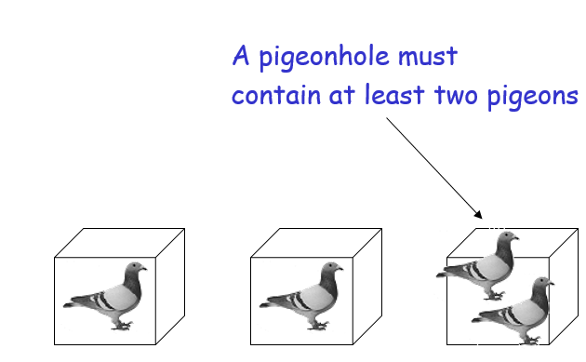
Pigeonhole Principle

Slide 7
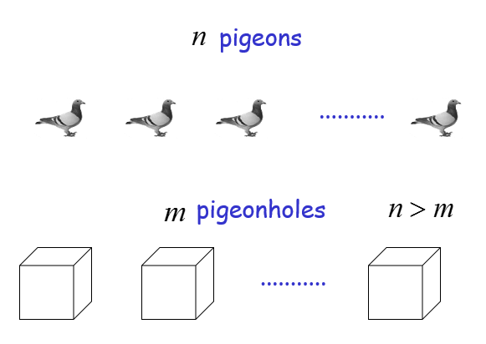
Pigeonhole Principle

Slide 8
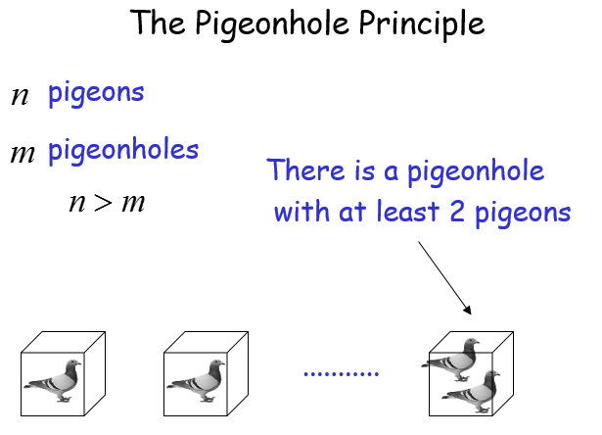
The Pigeonhole Principle

Slide 9
The Pigeonhole Principle and DFAs

Slide 10
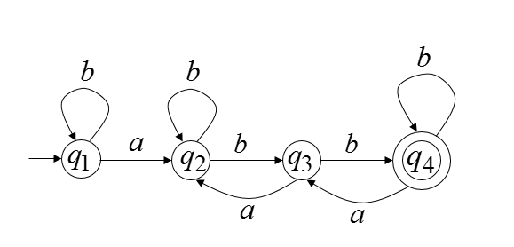
Pigeonhole Principle
DFA with states

Slide 11
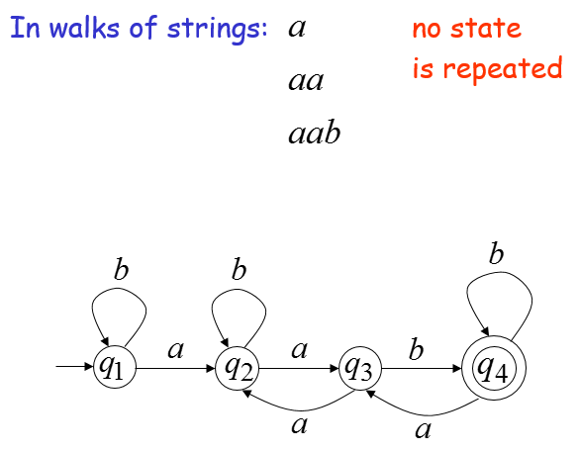
Pigeonhole Principle

Slide 12
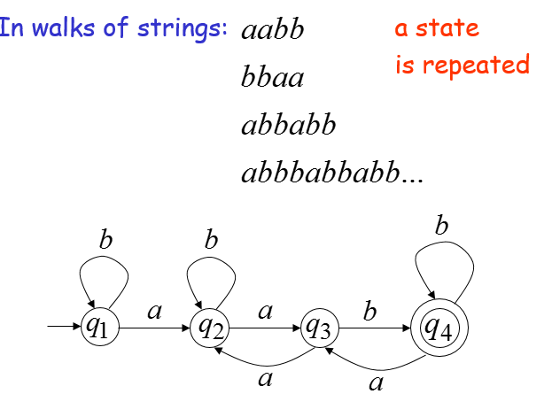
Pigeonhole Principle

Slide 13
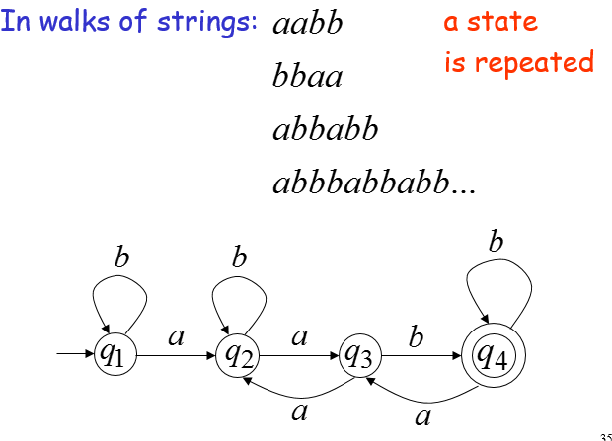
Pigeonhole Principle

Slide 14
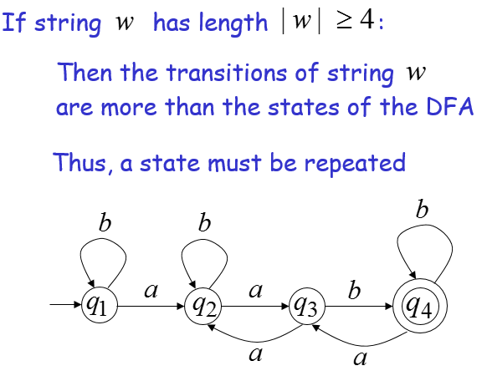
Pigeonhole Principle

Slide 15
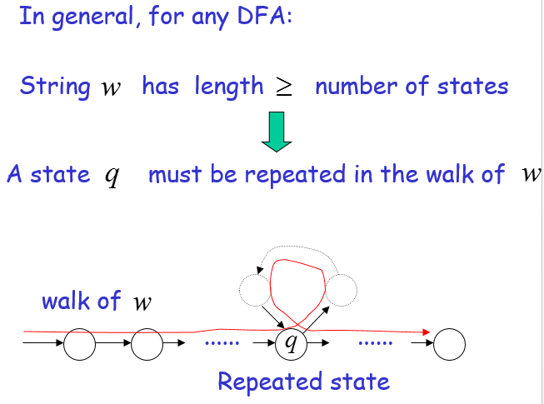
Pigeonhole Principle

Slide 16
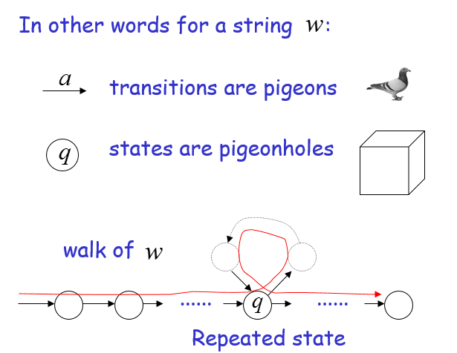
Pigeonhole Principle

Slide 17
The Pumping Lemma

Slide 18
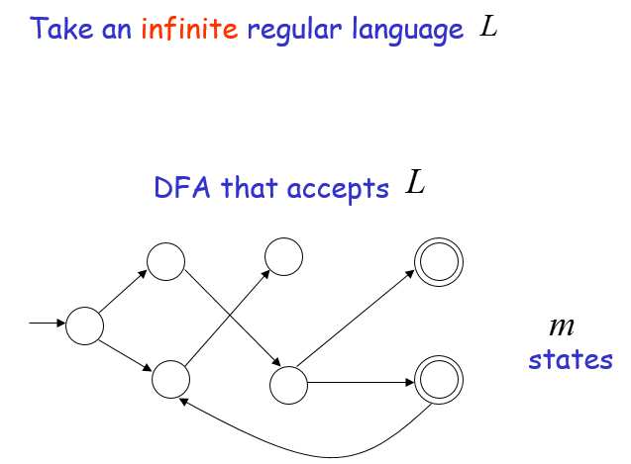
Pumping Lemma

Slide 19
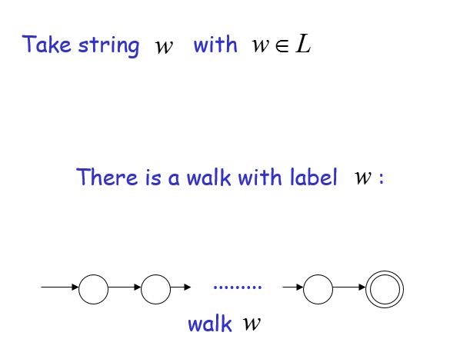
Pumping Lemma

Slide 20
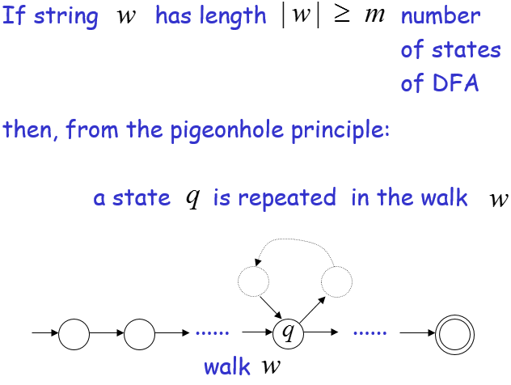
Pumping Lemma

Slide 21
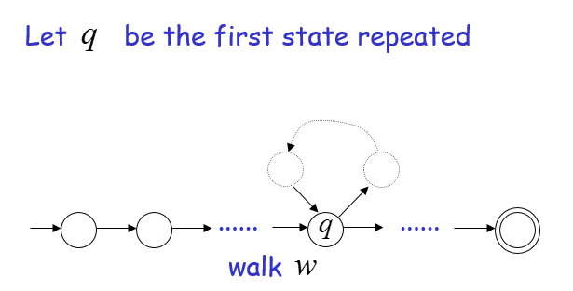
Pumping Lemma

Slide 22
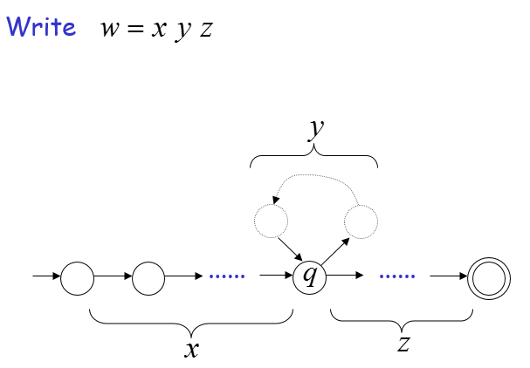
Pumping Lemma

Slide 23
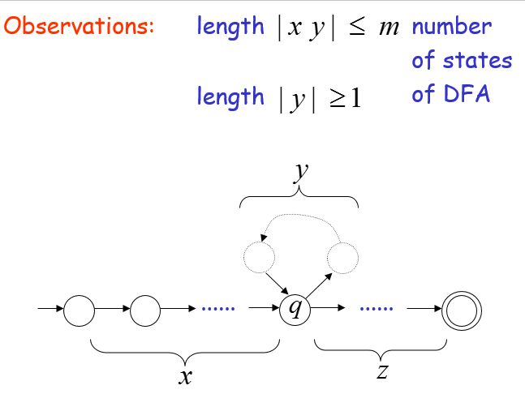
Pumping Lemma

Slide 24
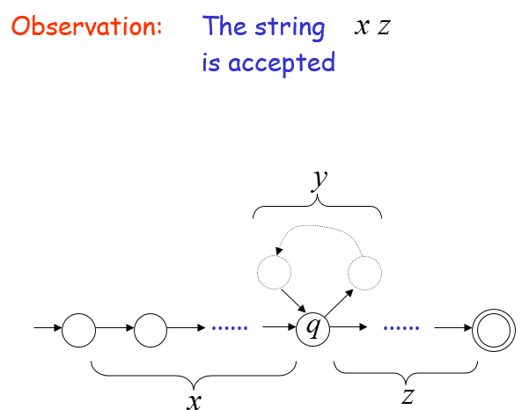
Pumping Lemma

Slide 25
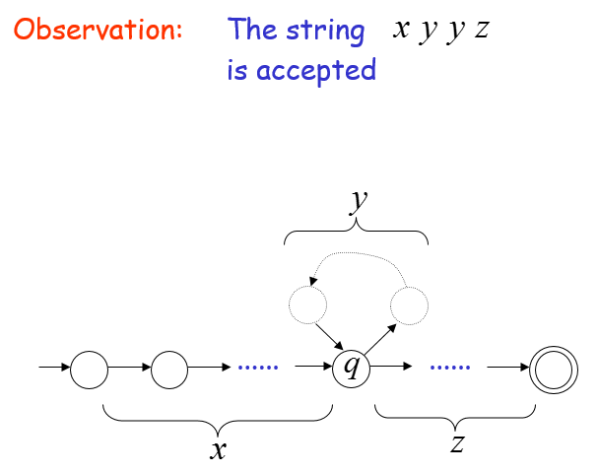
Pumping Lemma

Slide 26
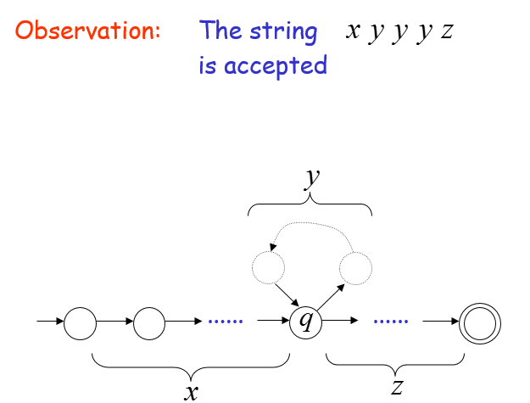
Pumping Lemma

Slide 27
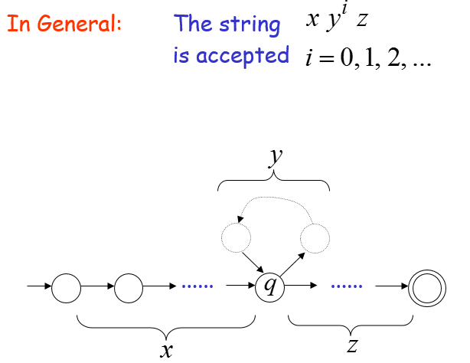
Pumping Lemma

Slide 28
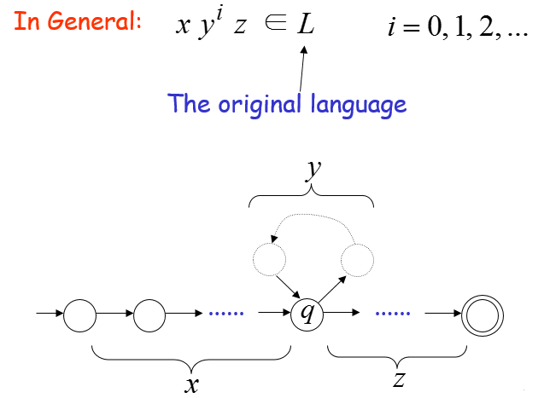
Pumping Lemma

Slide 29
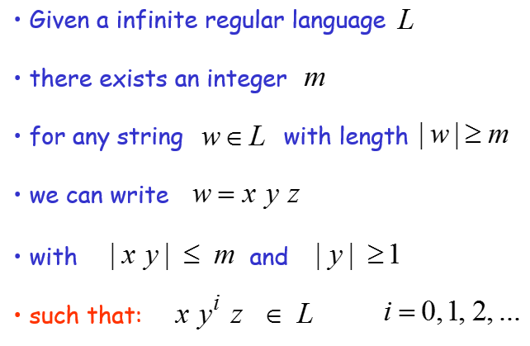
The Pumping Lemma

Slide 30
Applications of the Pumping Lemma

Slide 31
Applications of Pumping Lemma
Theorem:
The language
is not regular
Proof:
Use the Pumping Lemma

Slide 32
Pumping Lemma
Assume for contradiction that is a regular language
Since is infinite we can apply the Pumping Lemma

Slide 33
Pumping Lemma
Let be the integer in the Pumping Lemma
Pick a string such that:
length
We pick

Slide 34
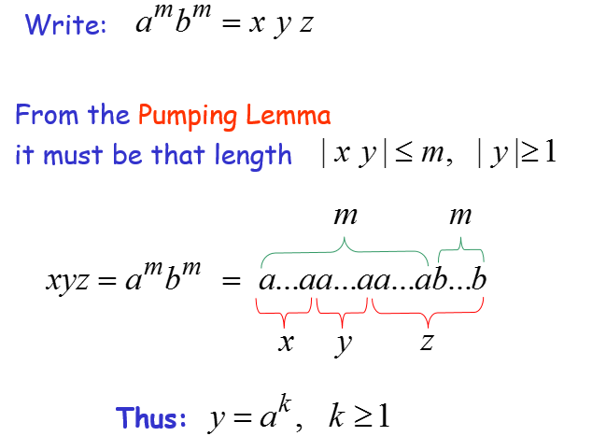
Pumping Lemma

Slide 35
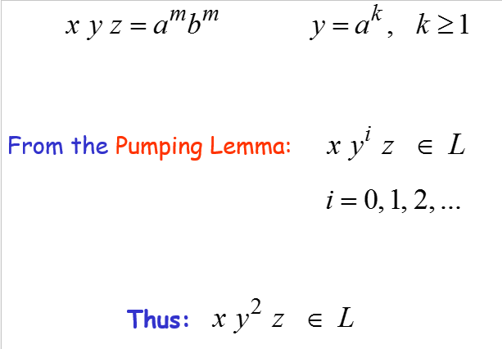
Pumping Lemma

Slide 36
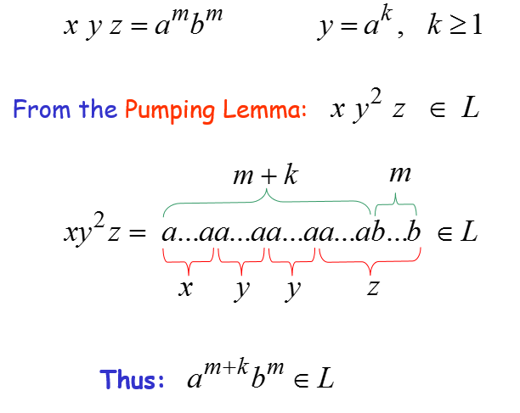
Pumping Lemma

Slide 37
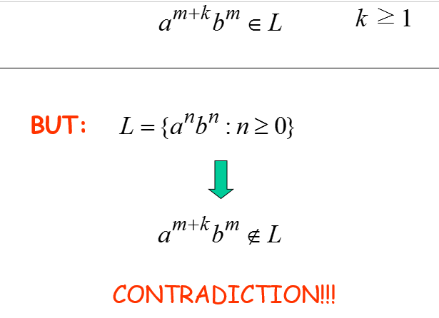
Pumping Lemma

Slide 38
Pumping Lemma
Therefore:
Our assumption that
is a regular language is not true
Conclusion:
is not a regular language

Slide 39
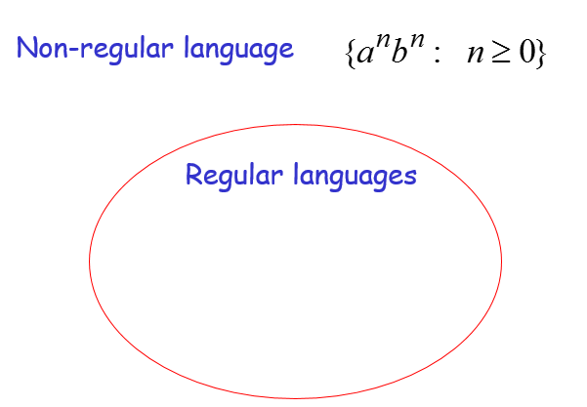
Pumping Lemma

Slide 40
Summary
Pumping lemma is used to prove whether the given language is regular or not

